Slide 1
NEXTHIKES IT SOLUTIONS Project : A basic calulator using python Sanskruti duche

Slide 2
Purpose of the Calculator
- To create a user-friendly calculator for basic operations.
- To explore GUI development using Python's Tkinter library.
- To practice exception handling and improve coding skills.
- To make a visually appealing tool with responsive design.

Slide 3
Challenges Faced
Designing a responsive and visually appealing UI.
Handling invalid inputs gracefully (e.g., division by zero).
Managing the layout for buttons and entry fields dynamically.
Implementing smooth interactions for user actions.
Ensuring compatibility across different platforms.

Slide 4
Why We Developed This Calculator
To demonstrate how Python can be used for interactive applications.
To simplify mathematical calculations with a colorful and intuitive UI.
To practice implementing real-world features like backspace and error handling.
To enhance understanding of event-driven programming.

Slide 5
Main Components •Tkinter: Python library used for building graphical user interfaces. •Key Components in Tkinter: •Root Window: The main container for the app (root = tk.Tk()). •Text Widget: Displays the current calculation and result (tk.Text). •Buttons: Used for input and triggering actions (tk.Button).

Slide 6
Code Explanation: Functionality 1. Global Variables: • calculation: Stores the ongoing arithmetic expression as a string. 2. Functions: • `add_to_calculation(symbol): • Appends user input (symbols) to the calculation. • Updates the display widget dynamically. • `evaluate_calculation(): • Evaluates the arithmetic expression using Python’s eval() function. • Handles errors like invalid input with exception handling. • `clear_field(): • Clears the calculation and resets the display.

Slide 7
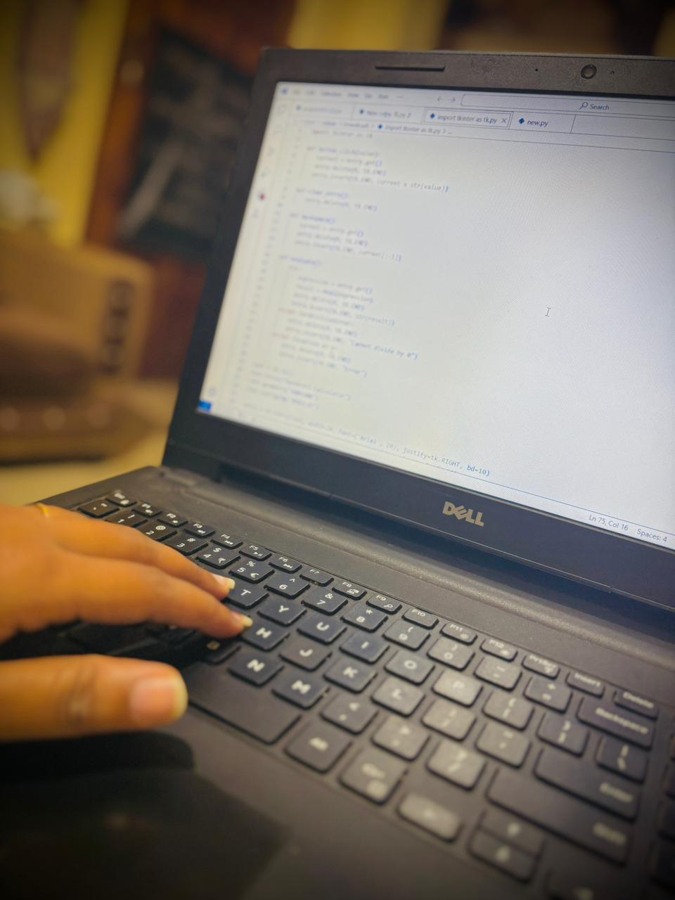
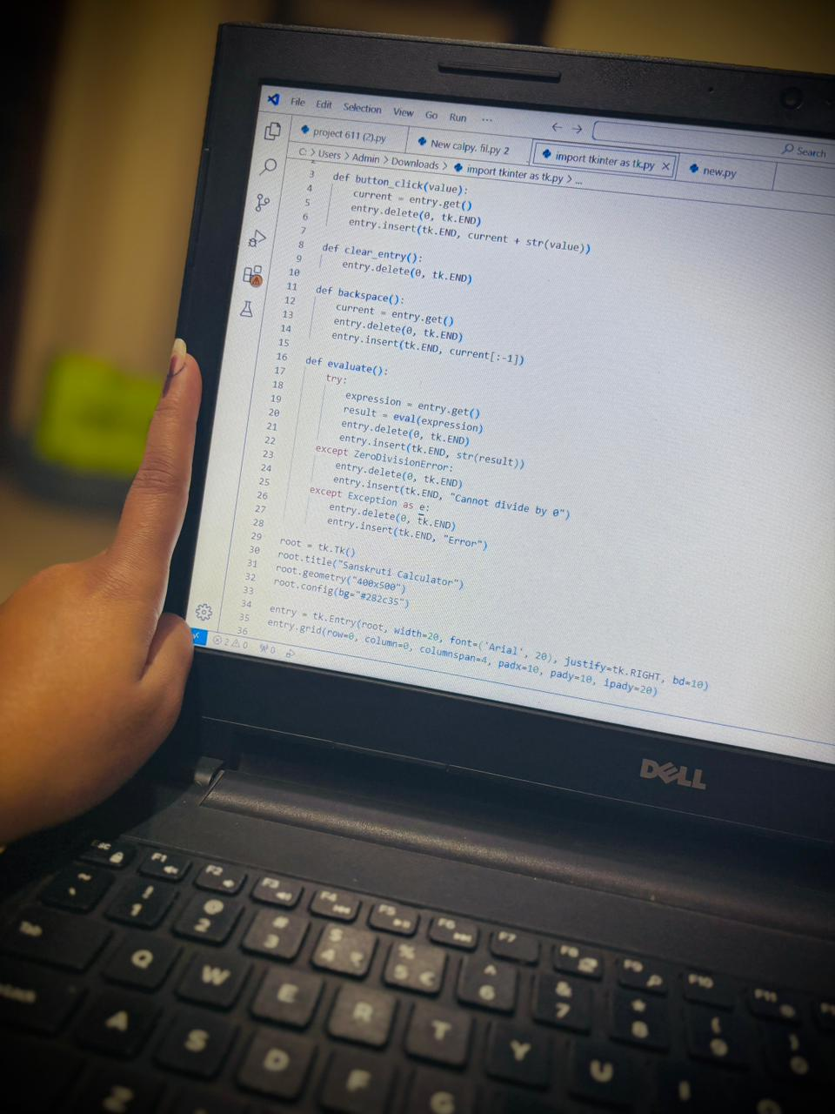
Code :

Slide 8

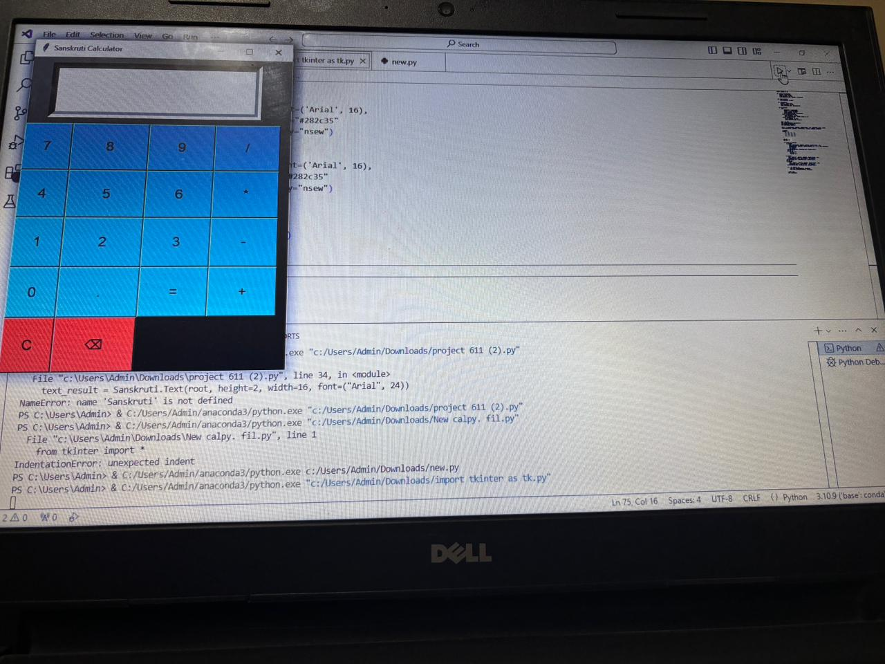
Demonstration
Live Demo:
Show how the calculator handles inputs, evaluates results, and resets on demand.

Slide 9
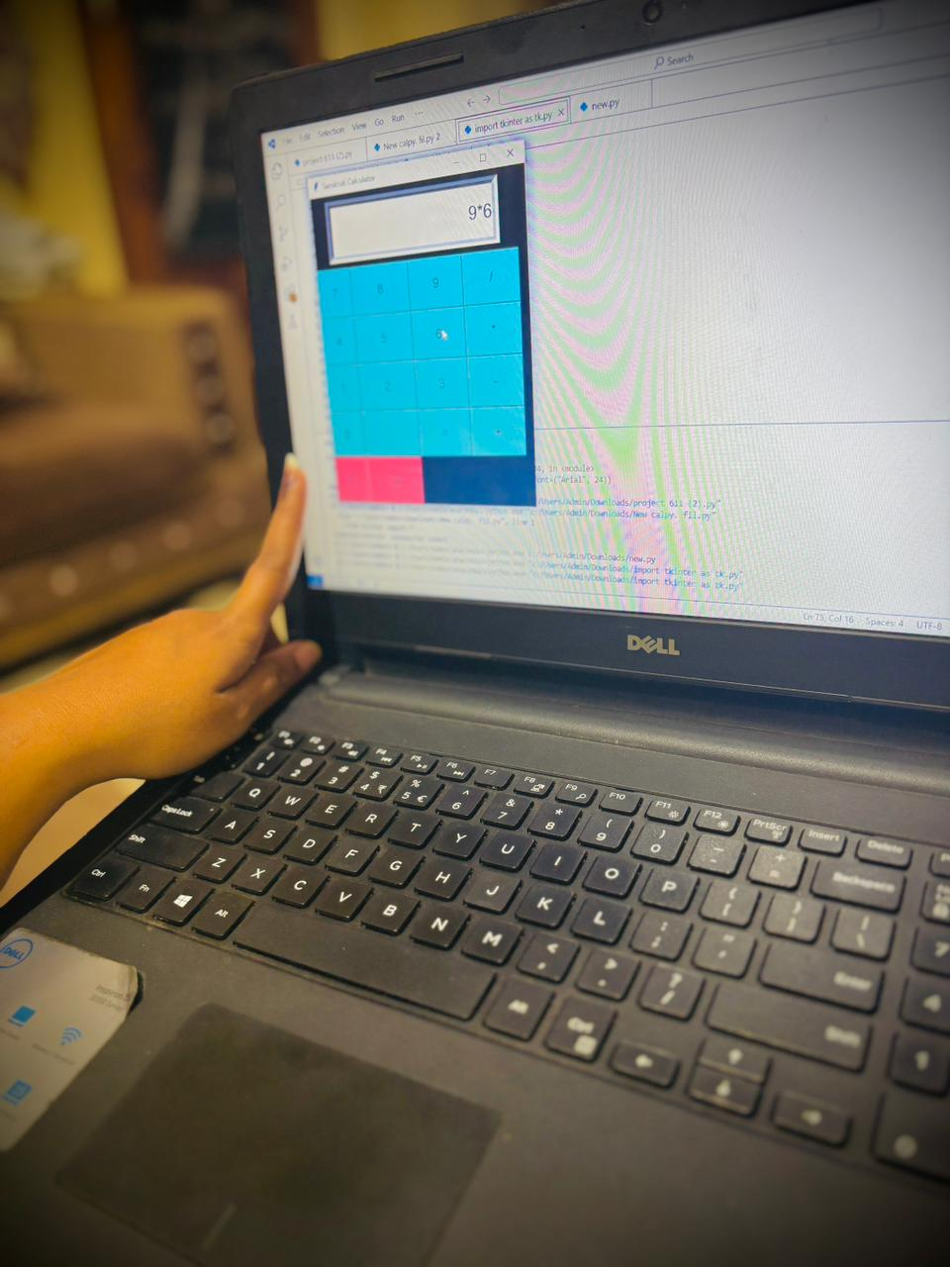
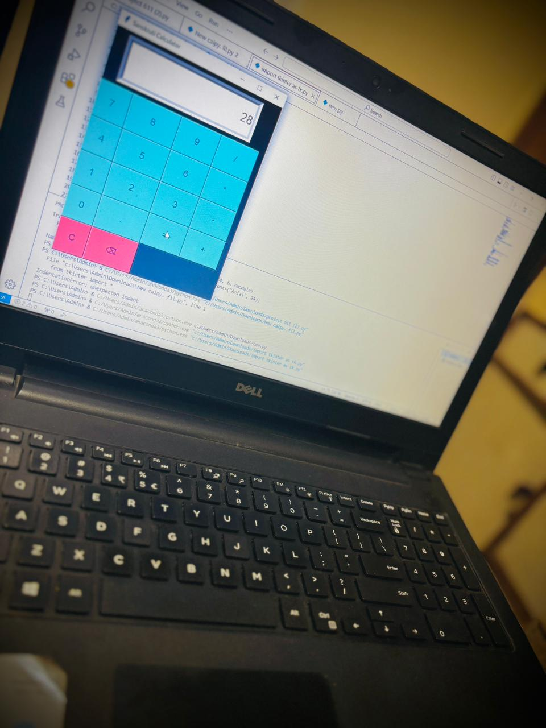
Features/Outputs: • Perform addition, subtraction, multiplication, and division. • Clear and reset functionality. • Dynamic display of results and calculations.

Slide 10
Enhancements
•Add support for advanced operations (square root, powers).
•Enhance error handling for invalid expressions.
•Improve UI/UX with themes and larger layouts.

Slide 11
CONCLUSION :
• Takeaway: A simple yet functional GUI calculator demonstrates the power of Python and Tkinter.
• Further Learning: Explore Tkinter to create more advanced and user-friendly applications.

Slide 12
Thank you

